Slide 1
UW SUBLEASING

Slide 2
PROBLEM

Slide 3
USER RESEARCH
Semi-structured interviews, questionnaires, and supplemental contextual research
Goal: understand how people navigate the sublease process in the UW area
Listers and tenants
2 listers, 3 tenants

Slide 4
USERS & ACTIVITIES
listers: people who want to lease their current housing to another person for a period of time shorter than their full lease
listing a sublease
looking for tenants
manage scheduled tours/inspections
communicate with current signed tenants
tenants: individuals looking to sublease housing
search for listings that meet their requirements/preferences
reach out & communicate to potential & current listers
schedule visits & tours
post info about themselves & preferences
Notes:
thevina

Slide 5
ENVIRONMENTS
some platforms used
facebook groups
e.g UW Housing, Subleases, Roommates, Apartments
sublet.com
Kopa
Yammer
Zillow
word of mouth (unofficial)
other unregulated communities united by culture/hobbies/religion/profession etc.
Notes:
thevina besides the physical space of the area being listed

Slide 6
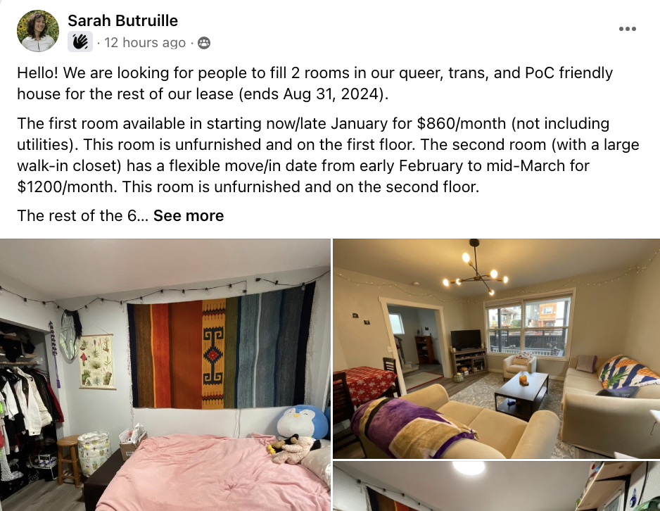
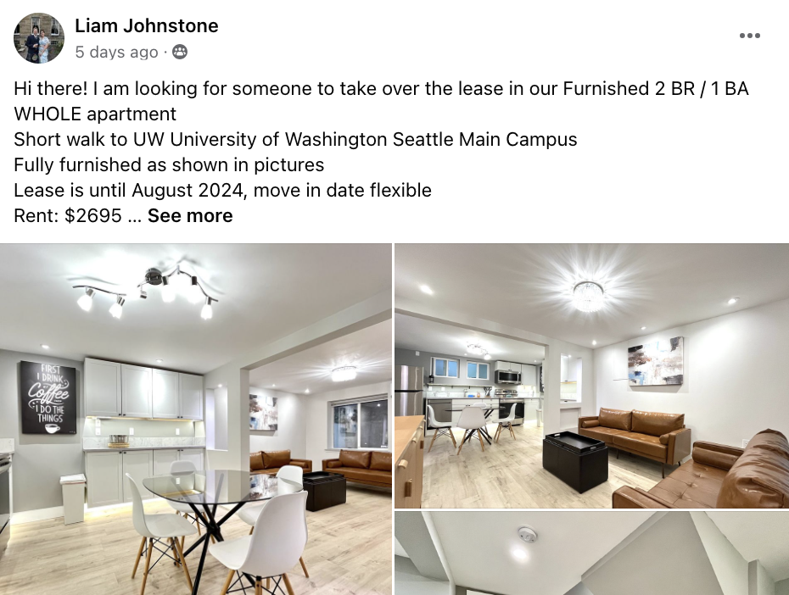
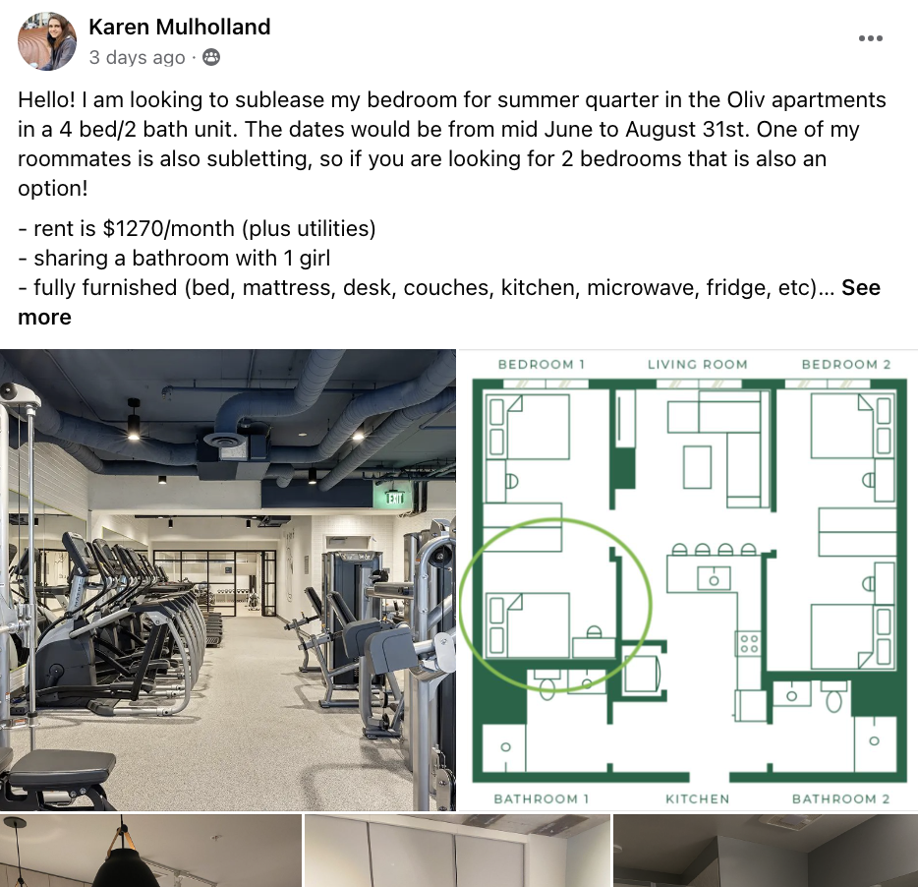
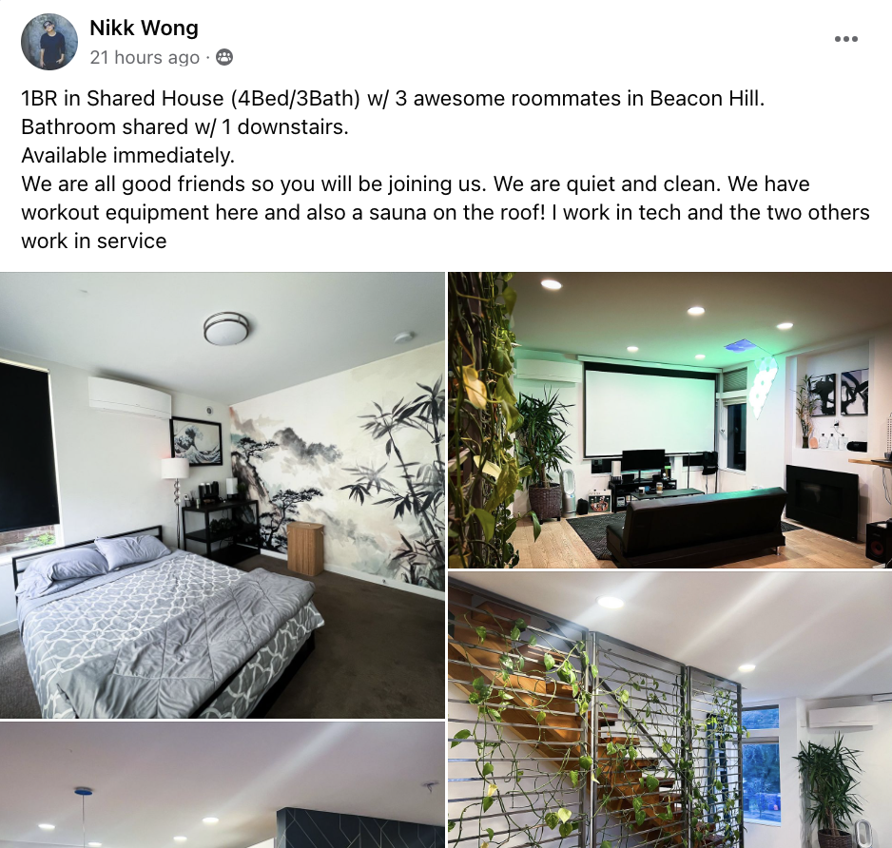
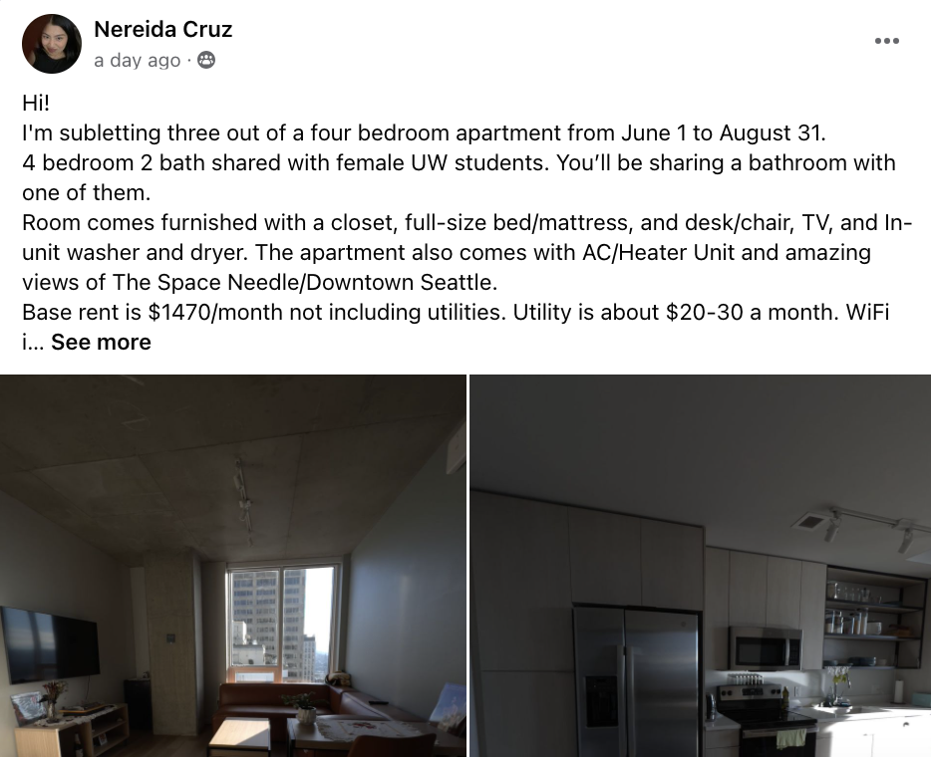
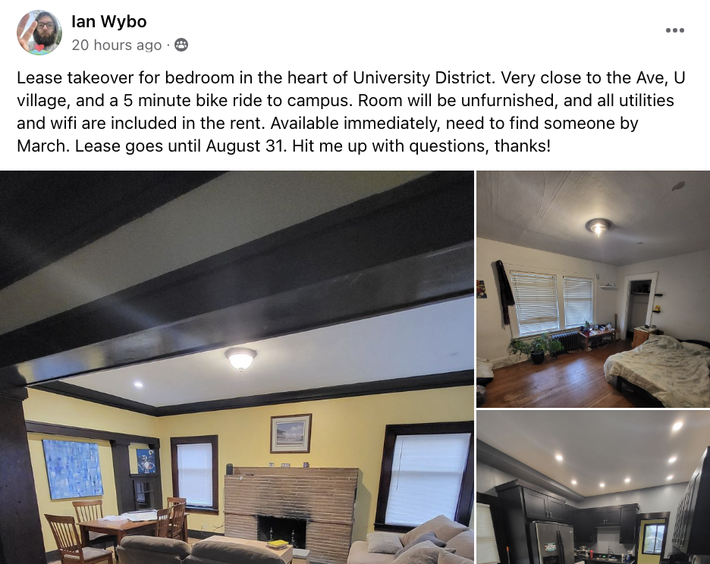
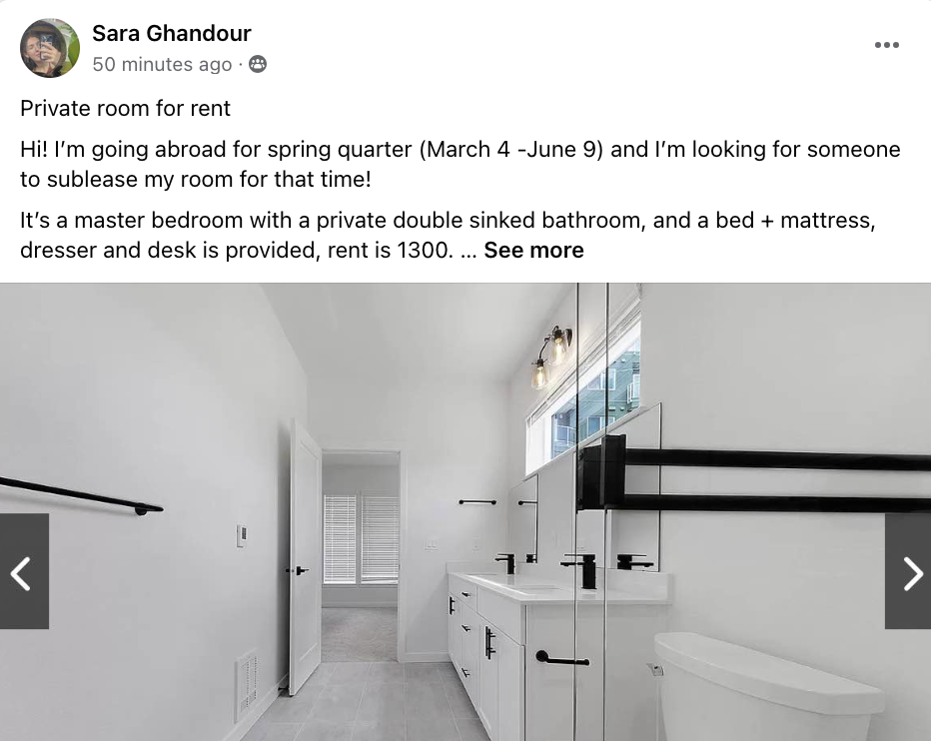

Slide 7
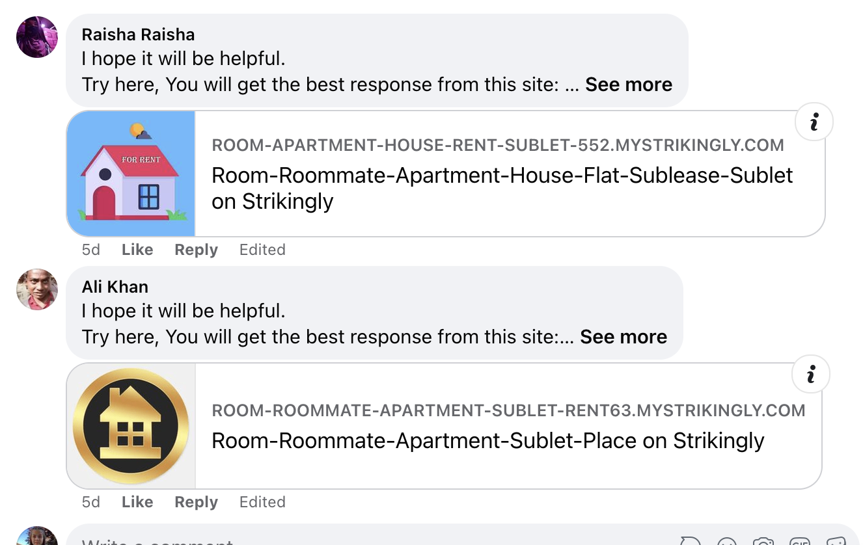
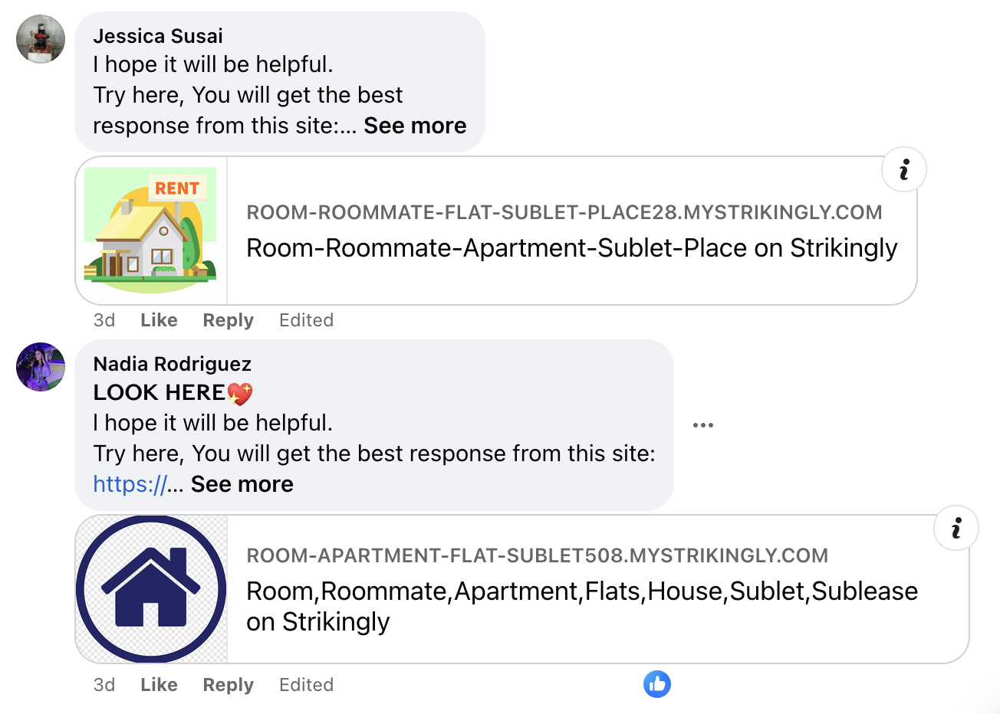
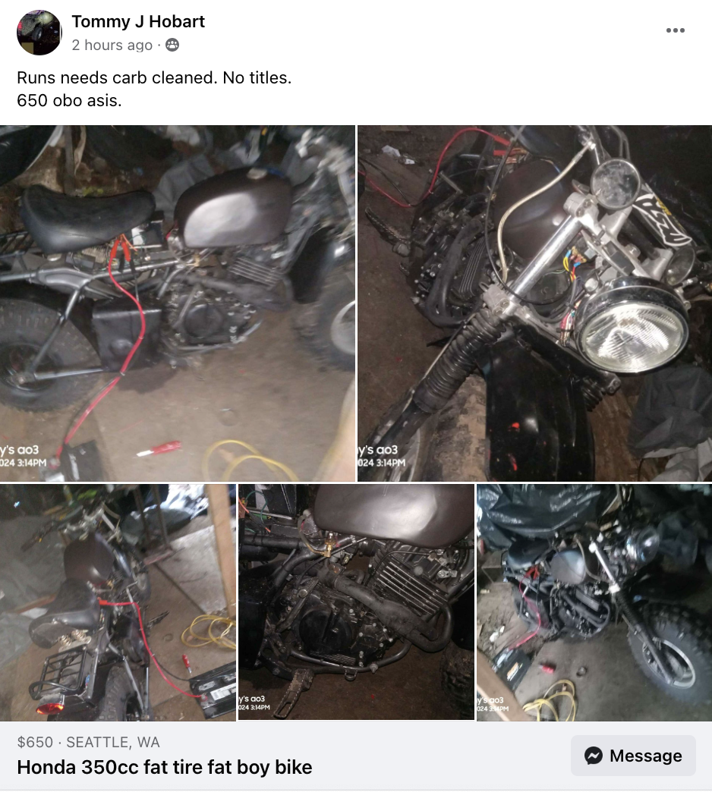
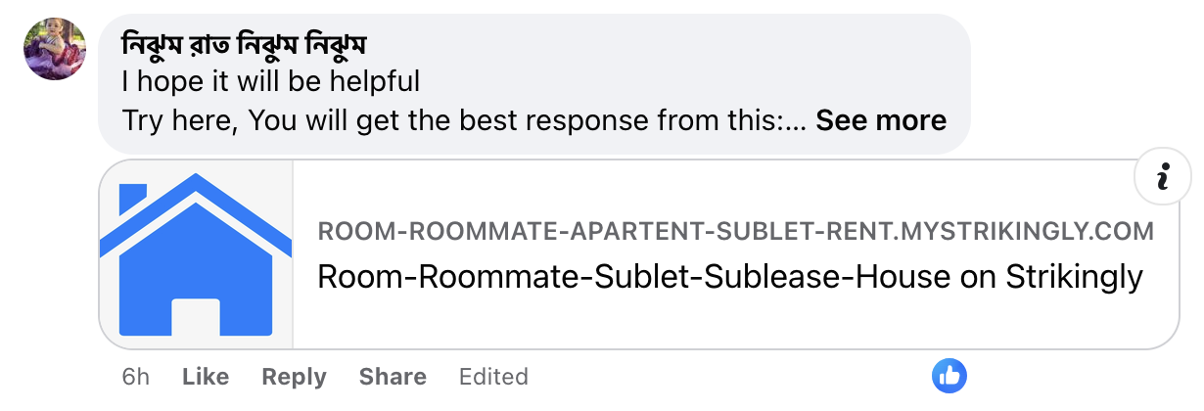

Slide 8
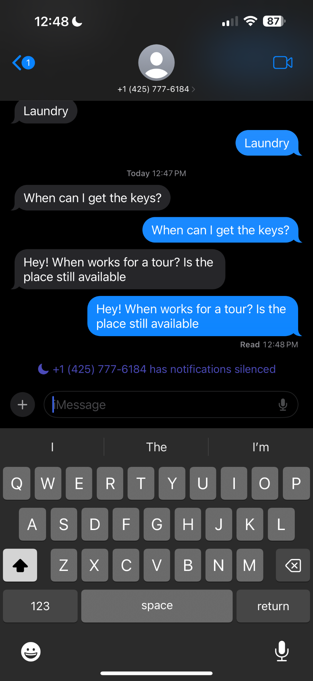
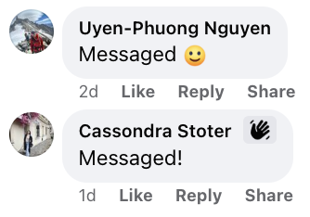
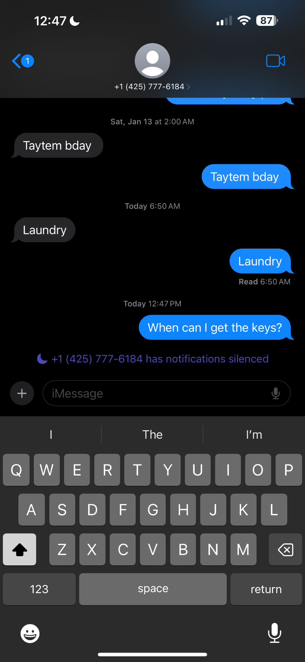
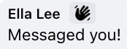
PAIN POINTS
Overwhelming endless scroll
Spam (hope it will be helpful)
Managing interest, logistics and communication

Slide 9
IDEAS
A marketplace platform that connects listers and tenants through:
Filterable, accessible listings
Facilitated communication
Interest transparency

Slide 10
Questions & Feedback?

